Slide 1
Efficient, verified cryptography in F*
Jean-Karim ZINZINDOHOUE
Joint work with Karthik BHARGAVAN

Slide 2
1 - Context

Slide 3
Why is cryptography verification important ?
OpenSSL’s poly1305 code
It does

Slide 4
Why is cryptography verification important ?
Testing is not sufficient to catch overflow bugs
OpenSSL’s example: too low probability, yet may be exploitable by attackers
2014’s HeartBleed: need of memory safety
Side channel mitigation
“ECDH Key-Extraction via Low-Bandwidth Electromagnetic Attacks on PCs” by Genkin, Pachmanov, Pipman & Tromer

Slide 5
So what can we prove ?
We aim at statically providing guarantees for:
Side channel mitigation
Preventing execution paths to depend on secret values
Memory safety and absence of overflows
E.g. no array accesses out-of-bounds, no overflows
Functional correctness
« My code can never go wrong »

Slide 6
2 – Example: elliptic curve verification

Slide 7
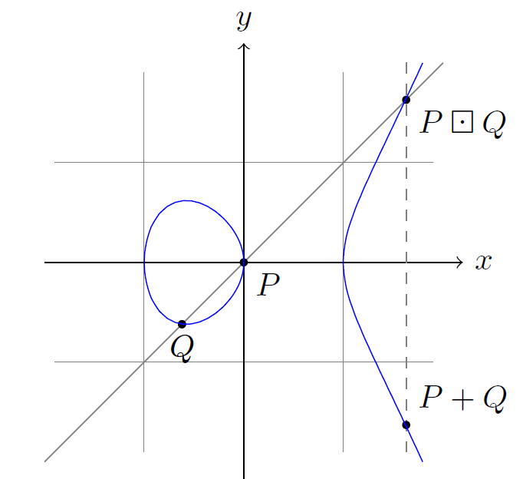
Elliptic curve cryptography
Weierstrass equation:
$\left(x, y\right)∈K^{2},$ $y^{2}= x^{3}+ax+b$
In cryptography $K$ is a finite field (e.g. Z/pZ with p a large prime)
Defines a group structure with an additive law
kP = P+…+P hard to inverse

Slide 8
A short intro on F*
ML-like language
Functional, no object oriented features
Rich type system
Refinement types, dependent types, indexes types etc.
Customizable lattice of monads
Verification automation via SMT-solver
Erasure to OCaml/F#
Soon compilation to Javascript, C++
Compilation to C for a restricted subset

Slide 9
Verification approach
Advantages
Drawbacks
Expressive language
Simple but precise functional correctness theorems
« All-in-one » proof
Modular, extensible proofs
Portable verified code
OCaml, F#, C
Soon: C++, javascript…
Not as efficient as hand-tuned assembly
Proving the correctness of the different backends is work in progress

Slide 10
2.1 – Side channel mitigation

Slide 11
Side channel mitigation
Target: low-level code for cryptographic primitives
Manipulated data-structures:
« Sensitive data » : integers, buffers of integers
Public values: integers (counters, lengths, indexes etc.)
Timing attacks: execution must NOT depend on secret values

Slide 12
Side channel mitigation
Idea: encode secret values as an F* abstract type
new type sint
The ghost function ‘v’ provides mathematical value of an sint:
val v: sint -> GTot int
val zero: z:sint{v z = 0}
The indexed type ‘usint n’ encodes unsigned machine integers of n bits
type usint (n:nat) = x:sint{v x >= 0 /\ v x < pow2 n}

Slide 13
Side channel mitigation
All computationally relevant functions take an sint as input return an sint:
Standard arithmetic (‘+’, ‘*’, ‘%’, etc.)
Bitwise operations (‘&’, ‘^’, ‘<<‘, etc.)
Cast, of_int, of_string, etc.
Comparison only via masking
E.g.:
uint32 gte(uint32 a, uint32 b) {
return (uint32) ~(((int64_t)a – b) >> 63);
}

Slide 14
Side channel mitigation
Consequence:
No going from sint to a native F* type
Unless in the Ghost effect
Impossible to branch on a comparison of sint (either with pattern matching or if-then-else)
Branching only on public values
Impossible to use the value of an sint to access an array cell
Impossible to use precomputed tables as input for instance

Slide 15
2.2 – Memory safety and integer overflow

Slide 16
Memory safety and integer overflow
sint are abstract: all operations are defined in the Sint module
One can chose her definition of the addition:
val uadd_1: #n:nat -> a:usint n -> b:usint n{v a + v b < pow2 n} ->
Tot (c:usint n{v c = v a + v b})
val uadd_2: #n:nat -> a:usint n -> b:usint n ->
Tot (c:usint n{v c = (v a + v b) % (pow2 n)})
val uadd_3: #n:nat -> a:usint n -> b:usint n ->
Tot (c:usint n{v a + v b < pow2 n ==> v c = v a + v b})

Slide 17
Memory safety and integer overflow
sint are abstract: all operations are defined in the Sint module
One can chose her definition of the addition:
val uadd_1: #n:nat -> a:usint n -> b:usint n{v a + v b < pow2 n} ->
Tot (c:usint n{v c = v a + v b})
val uadd_2: #n:nat -> a:usint n -> b:usint n ->
Tot (c:usint n{v c = (v a + v b) % (pow2 n)})
val uadd_3: #n:nat -> a:usint n -> b:usint n ->
Tot (c:usint n{v a + v b < pow2 n ==> v c = v a + v b})
The programmer’s
choice

Slide 18
Memory safety and integer overflow
Sint module: overflow prevention
FStar.Array: forbids array accesses out-of-bounds
E.g.: stateful array access
FStar.Seq:
abstract val index: #a:Type -> s:seq a -> i:nat{i < length s} -> Tot a
FStar.Array:
assume val index : #a:Type -> x:array a -> n:nat -> ST a
(requires (fun h -> contains h x /\ n < Seq.length (sel h x)))
(ensures (fun h0 v h1 -> (n < Seq.length (sel h0 x)
/\ h0==h1 /\ v=Seq.index (sel h0 x) n)))

Slide 19
2.3 – Functional correctness

Slide 20
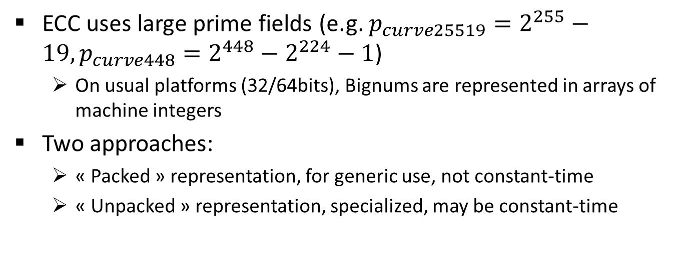
Representing Bignums
ECC uses large prime fields (e.g. $p_{curve25519}=2^{255}−19, p_{curve448}=2^{448}−2^{224}−1$)
On usual platforms (32/64bits), Bignums are represented in arrays of machine integers
Two approaches:
« Packed » representation, for generic use, not constant-time
« Unpacked » representation, specialized, may be constant-time

Slide 21
The unpacked representation
Idea: keep space left in each « limb » to avoid systematic overflow checks and carries.
Packed representation (curve25519 example):
lsb
msb
64 bits
Unpacked representation:
lsb
msb
51 bits
13 empty bits
In each limb

Slide 22
The unpacked representation
Idea: keep space left in each « limb » to avoid systematic overflow checks and carries.
Example: addition needs no (immediate) carry
a[0] |  | a[1] |  | a[2] |  | a[3] |  | a[4]
b[0] |  | b[1] |  | b[2] |  | b[3] |  | b[4]
1 extra bit used
a[0]+b[0] |  | a[1]+b[1] |  | a[2]+b[2] |  | a[3]+b[3] |  | a[4]+b[4]

Slide 23
Evaluating a Bignum
In the « packed » representation, value is immediate: binary representation of concatenated limbs
In the « unpacked » representation:
Templates : val templ: nat -> Tot nat
Associates each limb with its canonical number of bits
Evaluation function: val eval: array sint -> nat -> GTot nat
$eval\left(t, n\right)= \sum_{i=0}^{n−1}{2^{(\sum_{k=0}^{i−1}{templ\left(k\right)})} ∗t[i]}$

Slide 24

Evaluating a Bignum
Example: curve25519 sum ($p_{25519}=2^{255}−19)$
a[0] |  | a[1] |  | a[2] |  | a[3] |  | a[4]
bignum
b[0] |  | b[1] |  | b[2] |  | b[3] |  | b[4]
a[0]+b[0] |  | a[1]+b[1] |  | a[2]+b[2] |  | a[3]+b[3] |  | a[4]+b[4]
$eval\left(a, 5\right)=a\left[0\right]+2^{51}∗a[1]+2^{102}∗a[2]$ $+2^{153}∗a[3]$ $+2^{204}∗a[4]$
$eval\left(b, 5\right)=b\left[0\right]+2^{51}∗b[1]+2^{102}∗b[2]$ $+2^{153}∗b[3]$ $+2^{204}∗b[4]$
$$eval\left(a+_{bignum}b, 5\right)=eval\left(a, 5\right)+eval(b, 5)$$
$eval\left(a+_{bignum}b, 5\right)=(a\left[0\right]+b\left[0\right])+2^{51}∗(a\left[1\right]+b\left[1\right])+2^{102}∗(a\left[2\right]+b\left[2\right])$
$+2^{153}∗(a\left[3\right]+b\left[3\right])$ $+2^{204}∗(a\left[4\right]+b\left[4\right])$

Slide 25
Evaluating a Bignum
Example: curve25519 sum ($p_{25519}=2^{255}−19)$
Functional correctness proof
Bignum addition
Mathematical addition
$$eval\left(a+_{bignum}b, 5\right)=eval\left(a, 5\right)+eval(b, 5)$$

Slide 26
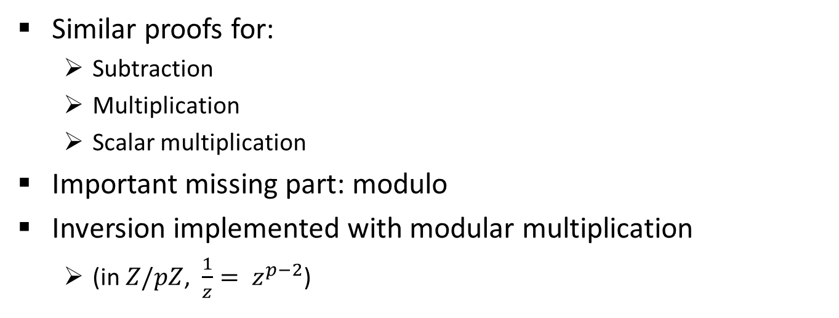
Functional correctness
Similar proofs for:
Subtraction
Multiplication
Scalar multiplication
Important missing part: modulo
Inversion implemented with modular multiplication
(in $Z/pZ$, $\frac{1}{z}= z^{p−2}$)

Slide 27
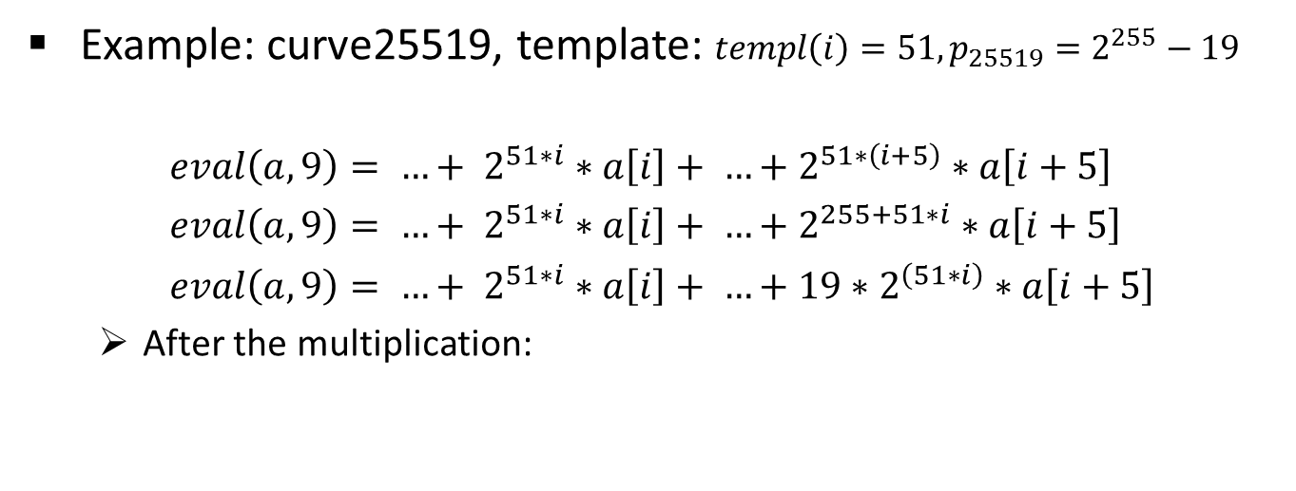
Convenient primes for modulos
Example: curve25519, template: $templ\left(i\right)=51, p_{25519}=2^{255}−19$
$eval\left(a,9\right)= …+ 2^{51∗i}∗a\left[i\right]+ …+2^{51∗\left(i+5\right)}∗a\left[i+5\right]$
$eval\left(a,9\right)= …+ 2^{51∗i}∗a\left[i\right]+ …+2^{255+51∗i}∗a\left[i+5\right]$
$eval\left(a,9\right)= …+ 2^{51∗i}∗a\left[i\right]+ …+{19∗2}^{\left(51∗i\right)}∗a\left[i+5\right]$
After the multiplication:
 |  | a[i] |  |  |  | a[i+5]
a[0] | a[1] | a[2] | a[3] | a[4] | a[5] | a[6] | a[7] | a[8]
a[0]+19*a[5] | a[1]+19*a[6] | a[2]+19*a[7] | a[3]+19*a[8] | a[4]

Slide 28
Convenient primes for modulos
Example: curve25519, template: $templ\left(i\right)=51, p_{25519}=2^{255}−19$
Simple reduction from a[9] to a[5] in constant-time
Follows two constant-time carry passes
We obtain that $eval\left(modulo\left(a\right)\right)=eval\left(a,9\right)\% p_{25519}$
Memory safety is still enforced everywhere thanks to the unpacked representation
Only the modulo is not generic
Per prime implementation
The rest of the Bignum library only need a template!

Slide 29
From Bignum to Curves
A curve point is
2 coordinates in the affine coordinate system
3 coordinates in the projective or the jacobian coordinate systems
Point addition and doubling
Uses the Bignum interfaces
Linked to a formal theory proven in Coq
We show that the set of computed equations on point coordinates executes the addition or doubling operation as supposed to

Slide 30
From Bignum to Curves
From the Coq theory and SAGE scripts we assume that curve points are a group with additive law
Scalar multiplication implementation:
Relies on a Montgomery ladder algorithm
Independant from the point nature (only the additive law matters)

Slide 31
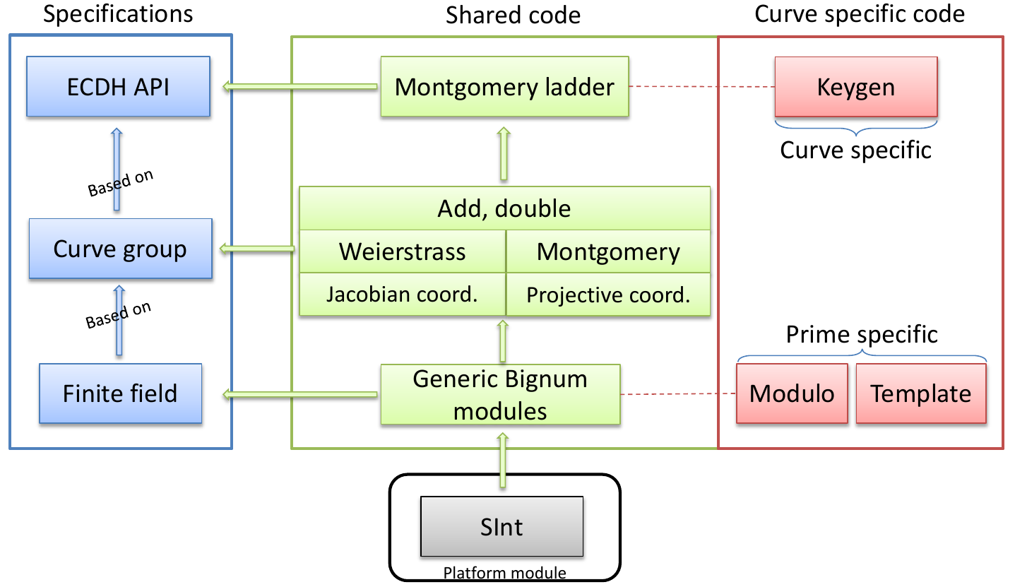
Modular code structure

Slide 32
2.3 – Towards better performances for F* cryptographic code
Work in progress with N. Swamy, J. Protzenko, P. Weng (MSR Redmond),
and C. Fournet (MSR Cambridge)

Slide 33
Performances
As of now, curve25519 extracted to Ocaml is
≈ 200x slower than C code
Algorithmic inefficiencies
Missing optimizations in the F* backend
Boxed 64bits integers
Etc.
Code is effectively C code written in F*
We need a low-level backend for better performances

Slide 34
New pipeline
F* … Low* C* …
Erasure
Kremlin
First-order fragment of F*
Ideally one-to-one correspondence with C
Mimic C’s statements with let-bindings
Primitives for buffer create/read/write
A fragment of C
Stack only
As faithful as possible

Slide 35
Specific memory model
F*:
Memory modeled by a stack of « frames »
A frame: map from references to values
Low* effect invariant:
The memory structure is identical before and after the call
The frames are the sames on both sides
Each frame contains exactly the same references
Hence new frames have to be pushed and popped (similar to C blocks) before allocating a new object
New « buffer » type:
View into an allocated sequence of data
Simulates some pointer arithmetic

Slide 36
Proofs (in MSR Redmond)
Semantic preservation during the erasure phase: in progress
Safety: a low* program is safe implies that the corresponding C* program is safe
Correction: C* simulates Low*
Side channel protection: in progress, show that a Low* program’s trace will not depend on a secret

Slide 37
Current results and future goals
Chacha20, Poly1305 and AEAD-ChachaPoly extract via the backend.
Chacha20 is ~ 2x slower than reference implementations (with asm)
Goals:
Implement all of miTLS crypto and buffer management in Low*
Compile a larger subset of F* to C++ (all of miTLS ?)

Slide 38
Thank you !

